Slide 1
DubTouch: Exploring Human to Human Touch Interaction for Gaming in Double Sided Displays
Oğuz Turan Buruk
Oğuzhan Özcan

Slide 2
Story begins with…

Slide 3
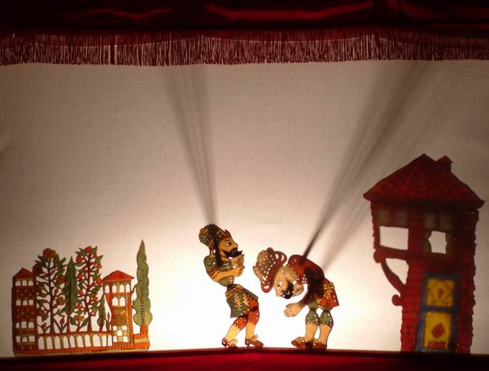

Slide 4
Double Sided view in Shadow Play

Slide 5
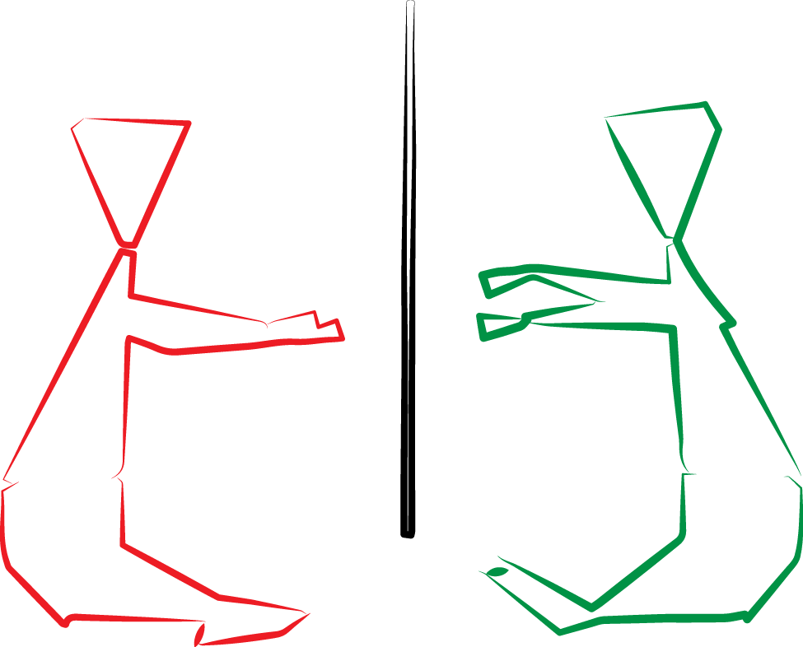
Notes:
When you think about an interactive environtment with double sided displays

Slide 6
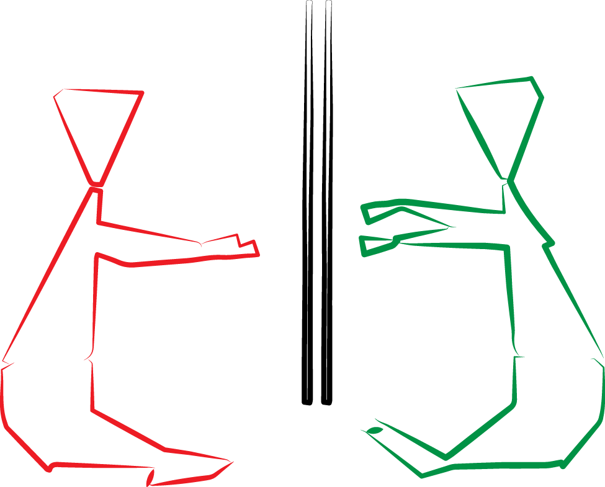
Notes:
If a put two display in a way that their backs are facing each other

Slide 7
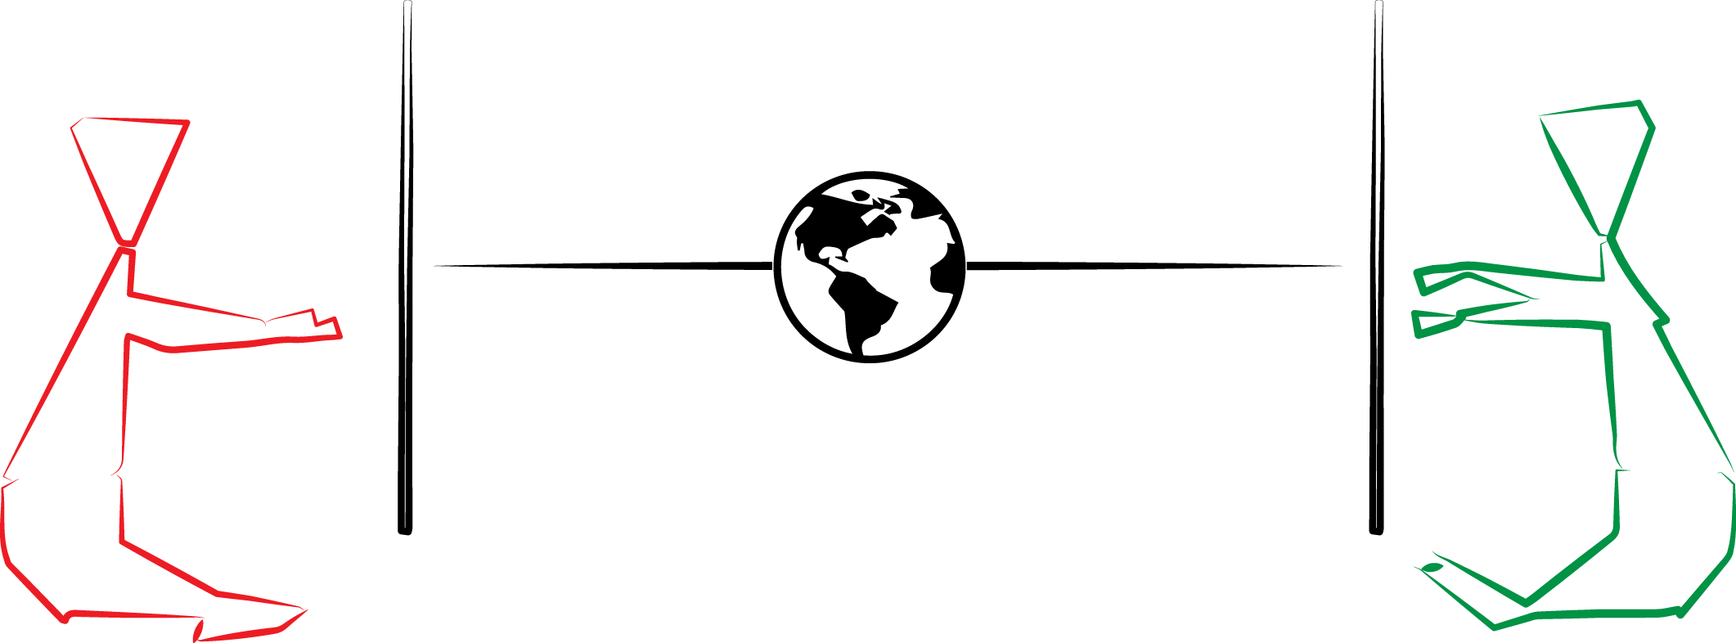

Slide 8
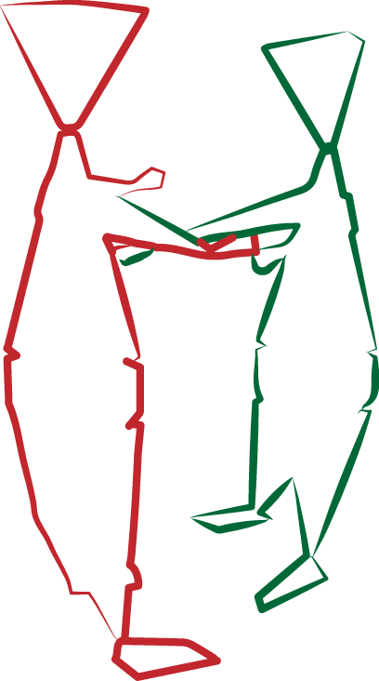
Co-Located Users

Slide 9
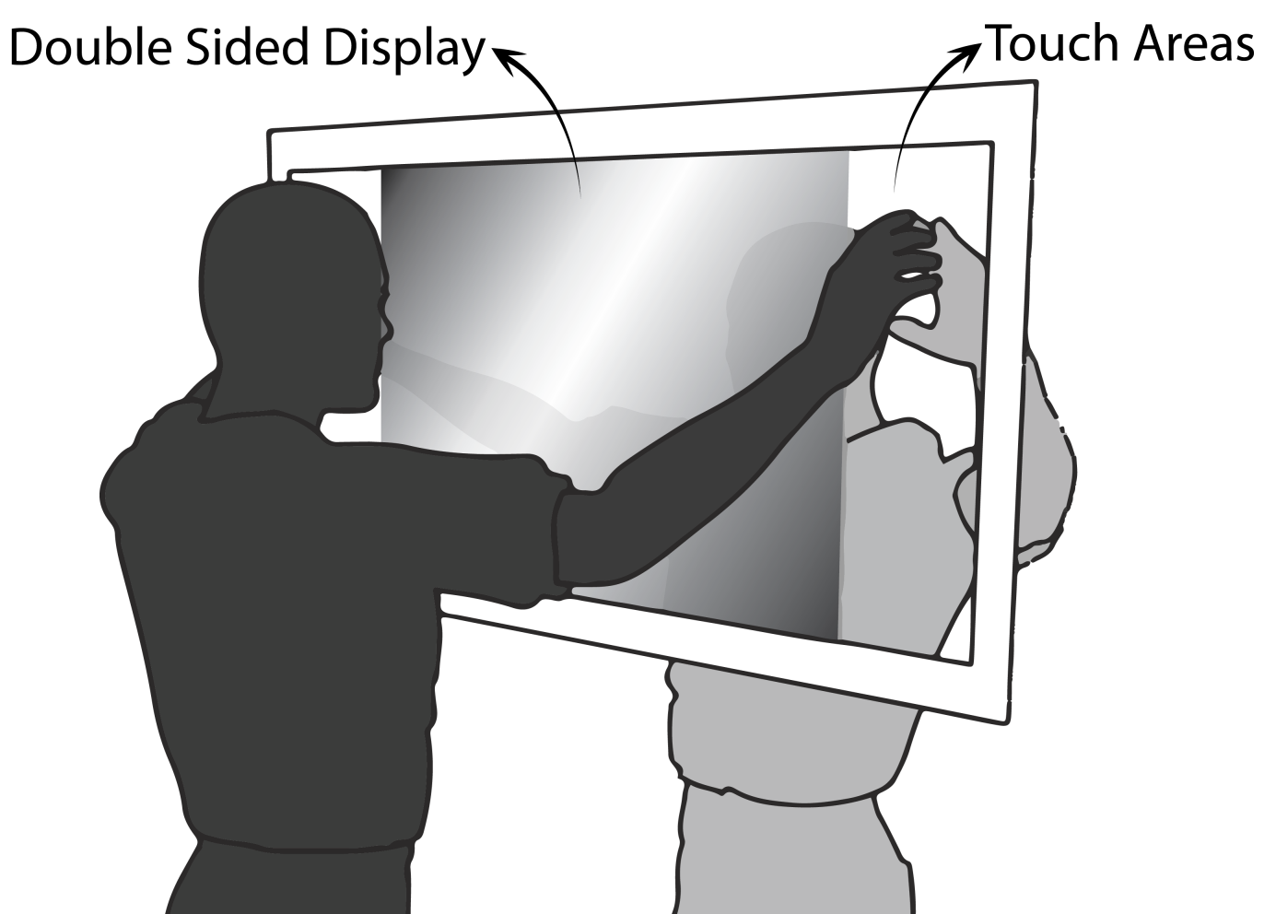
DubTouch
Human to Human Touch in Double Sided Displays

Slide 10
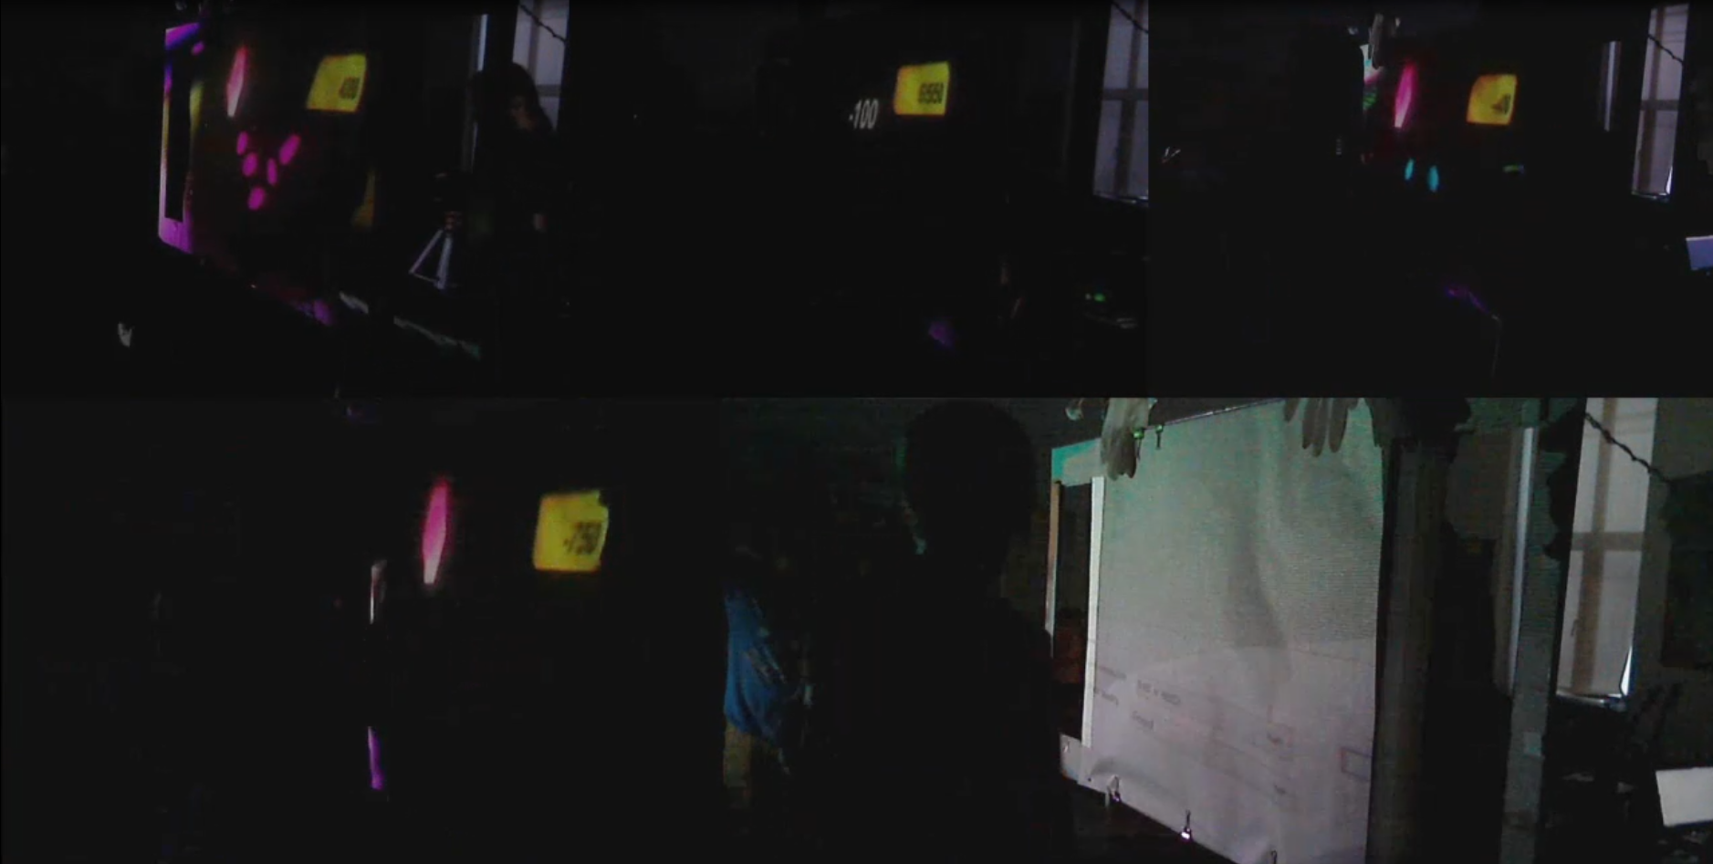

Slide 11
User Study
Design Workshop

Slide 12
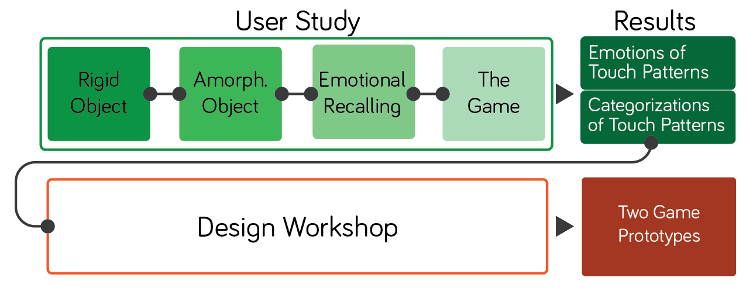
Method

Slide 13
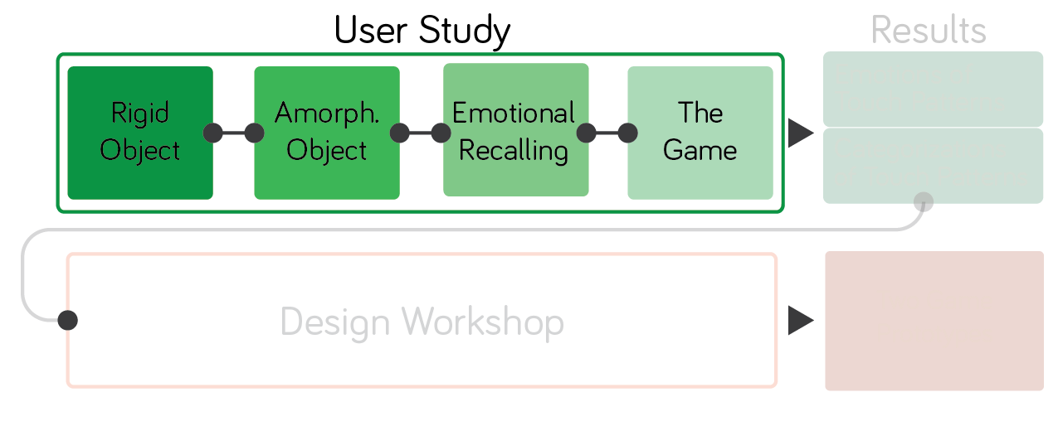

Slide 14
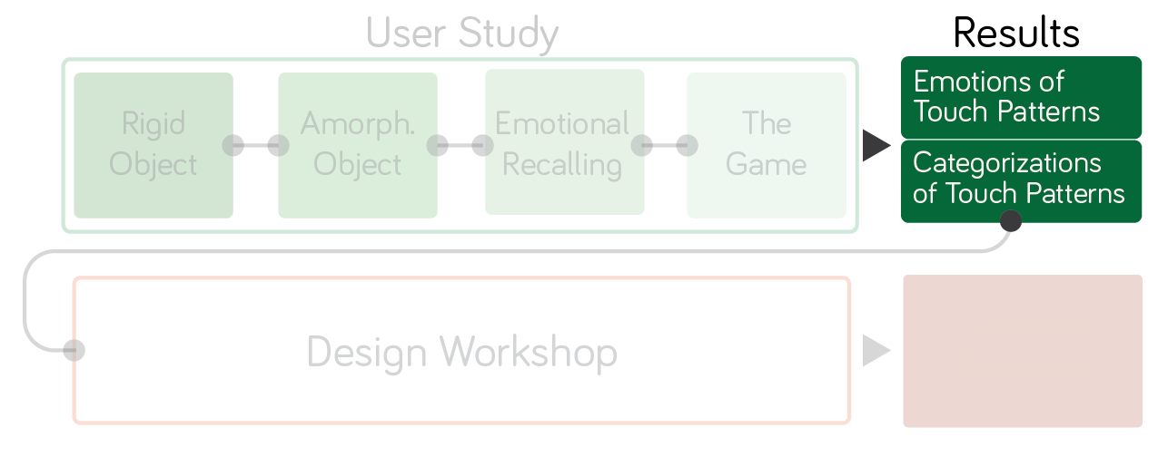

Slide 15
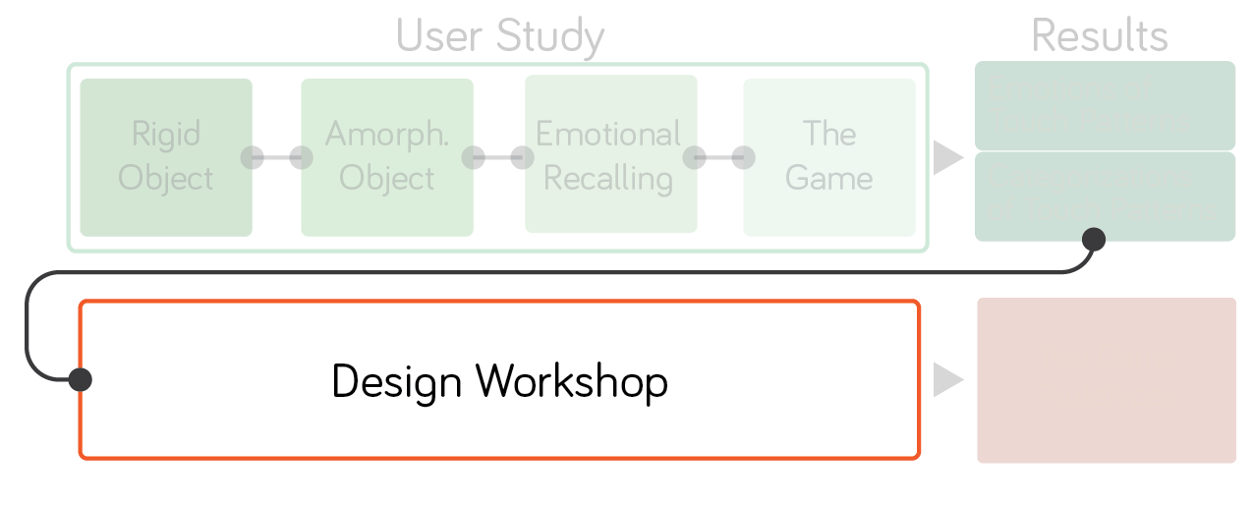

Slide 16
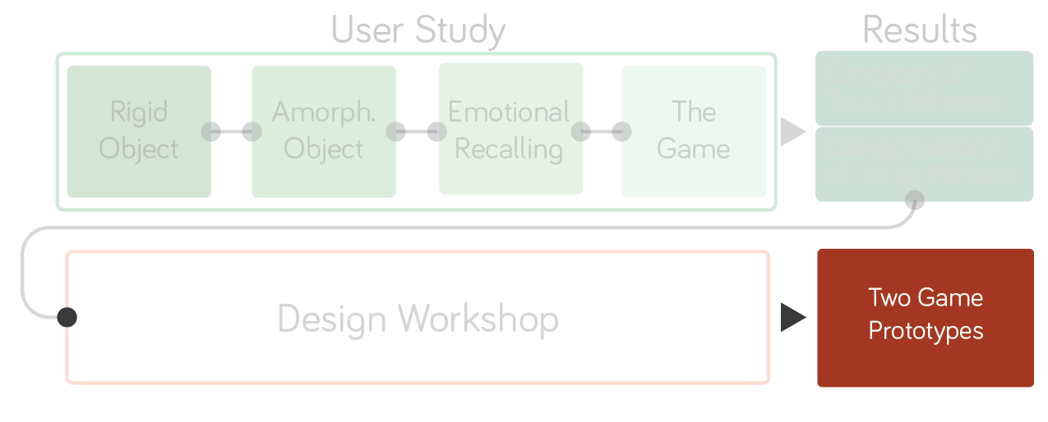

Slide 17
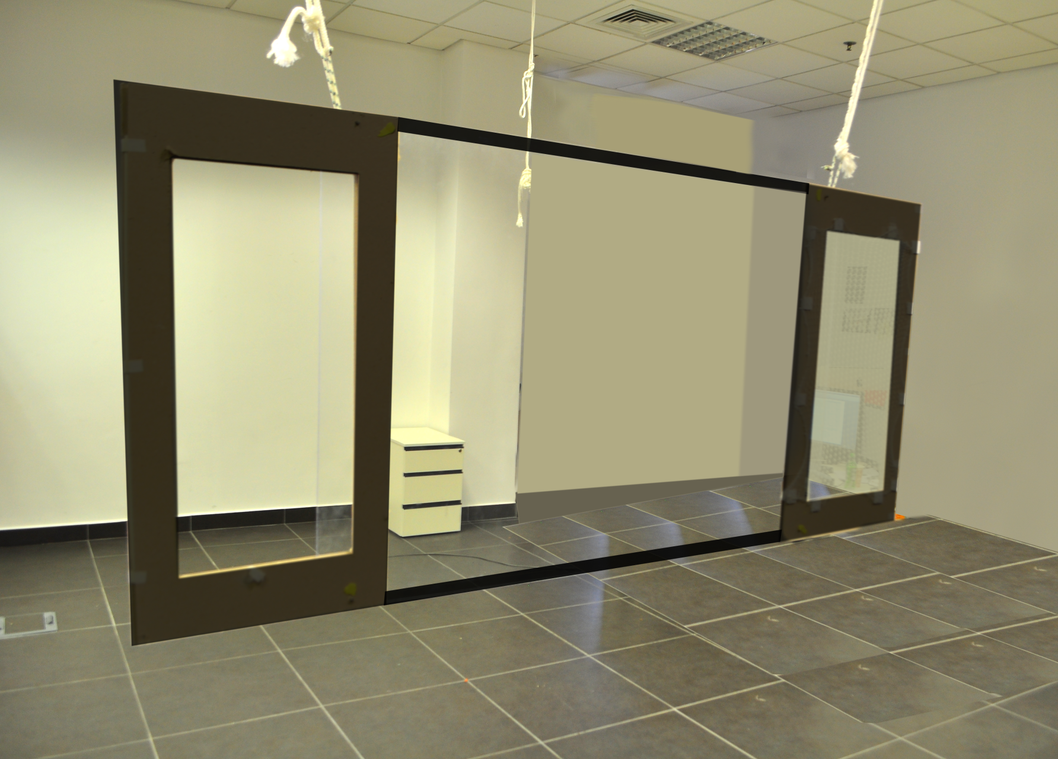
How?
Experience Prototype

Slide 18
24 cm
Elastic
Cloth
70 cm
53 cm
100cm
Experience Prototype

Slide 19
User Test

Slide 20
User Tests
Understanding the user’s reactions and desires.

Slide 21
10 Participants

Slide 22
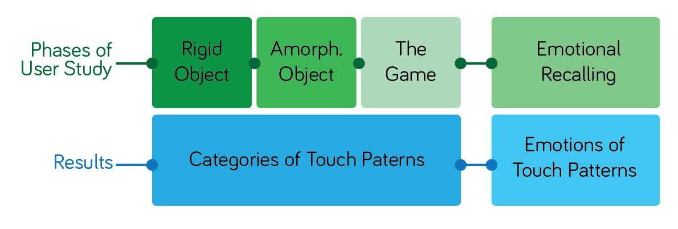

Slide 23
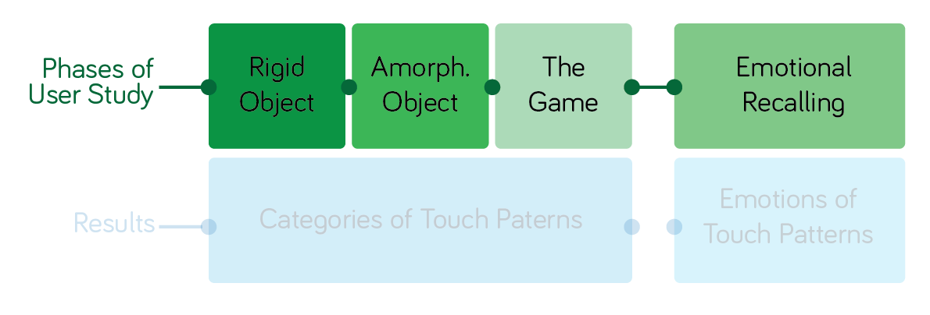

Slide 24
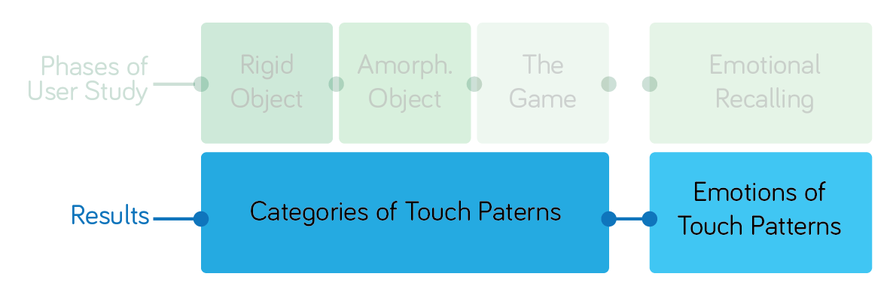

Slide 25
User Tests
Touch Patterns
movement area
posture of the hand
touch style
one or two hand usage
collaboration of users

Slide 26
Video Observation
Coded Actions

Slide 27
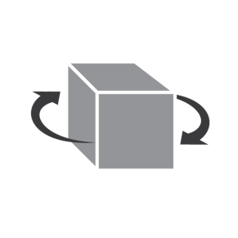
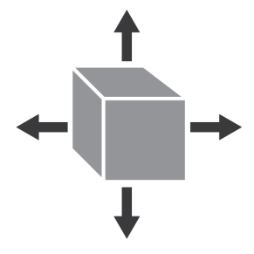
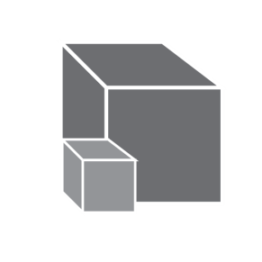
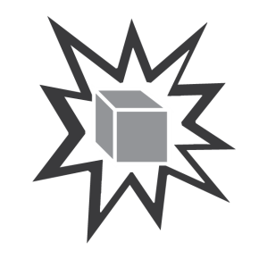
Rigid Object
1st Phase
rotate
translate
scale
explode
smash
corner
transform
user’s proposal

Slide 28
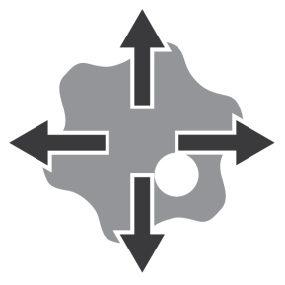
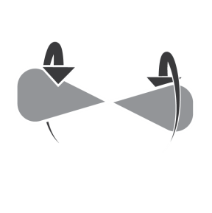
Amorphous Object
2nd Phase
expand
twist
roll
deform
user’s proposal

Slide 29
Emotional Recalling
3rd Phase
1st Stage
Emotions and Feelings

Slide 30
Emotional Recalling
3rd Phase
2nd Stage
Joy
Melancholy
Love
Tension
Fear
Touch Patterns

Slide 31
The Game
4th Phase
Testing to play a game with the touch patterns created

Slide 32
Design Workshop

Slide 33
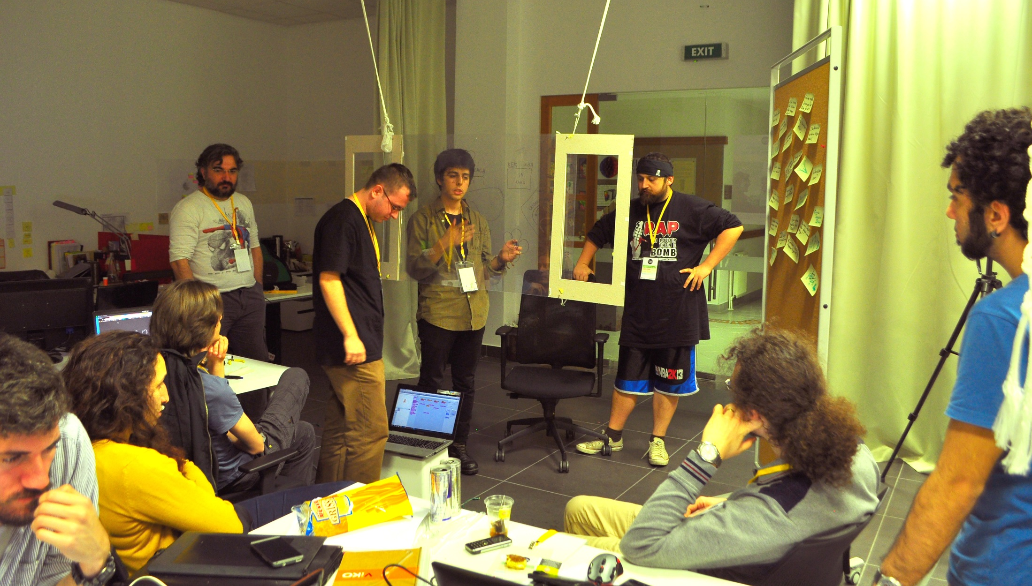
Design Workshop

Slide 34
Design Workshop
Is it possible to design uncommon games?
Do these games satisfy the user test results?

Slide 35
Design Workshop
Is it possible to design uncommon games?
Do these games satisfies the user test results?

Slide 36
Design Workshop
Is it possible to design uncommon games?
Do these games satisfy the user test results?

Slide 37
Design Workshop
10 Experts
48 Hour
Improved Prototype
Wizard of Oz

Slide 38
Design Workshop
2 Coders
2 Interaction Designers
2 Sound Designers
2 Illustrators
2 Modelers

Slide 39
Design Workshop
2 Teams
2 Games

Slide 40
Results

Slide 41
User Tests
170 Touch Patterns
6 Categories
Evaluation of Categories
Emotions of Touch Patterns

Slide 42
User Tests
170 Touch Patterns
6 Categories
Evaluation of Categories
Emotions of Touch Patterns

Slide 43
User Tests
170 Touch Patterns
6 Categories
Evaluation of Categories
Emotions of Touch Patterns

Slide 44
User Tests
170 Touch Patterns
6 Categories
Evaluation of Categories
Emotions of Touch Patterns

Slide 45
User Tests
170 Touch Patterns
6 Categories
Evaluation of Categories
Emotions of Touch Patterns

Slide 46
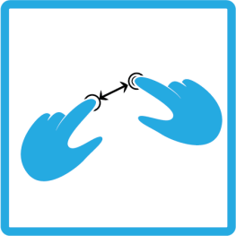
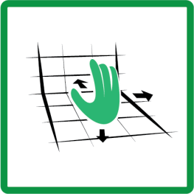
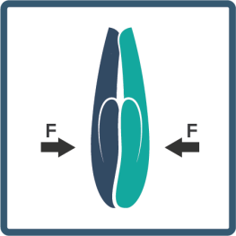
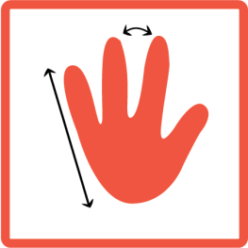
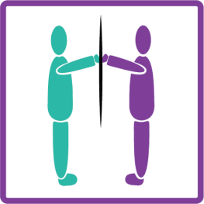
User Tests
Categories
Direct Manipulation
Two Hands
3D Space
Physical Impact
Hand Posture
Two User

Slide 47
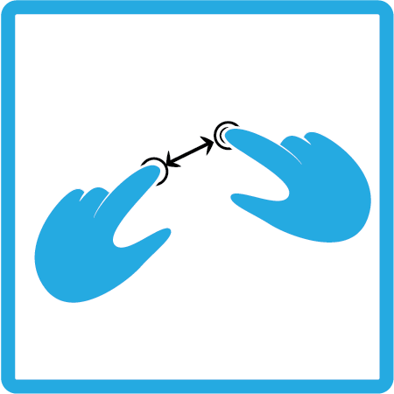
User Tests
Direct Manipulation
Notes:
Direct Manipulation refers to actions which aim to control the content directly manipulating its physical properties. Although, our environment does not let player to touch the object directly over the screen, the patterns which are transferred directly from the touch screen interaction, which mostly depends on direct manipulation, falls under this category.

Slide 48
User Tests
Two Hands
Notes:
If the touch pattern requires the use of both hands, it falls under Two Hand category.

Slide 49
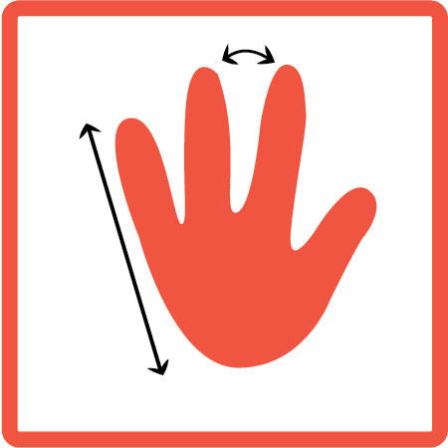
User Tests
Hand Posture
Notes:
Fist or Firm Grip

Slide 50
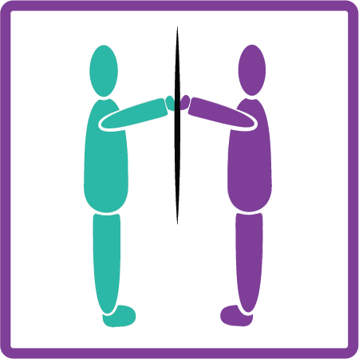
User Tests
Two User
Notes:
Patterns which are composed of the different or synced actions of Two Users were put under the category of Two users. In general, it may be expected that the nature of the users to design patterns in a way that include both of the users in the action. However, some patterns are proposed as if they are conducted without the contribution of the second user. Therefore, the patterns which is involves both users effectively are put under this category.

Slide 51
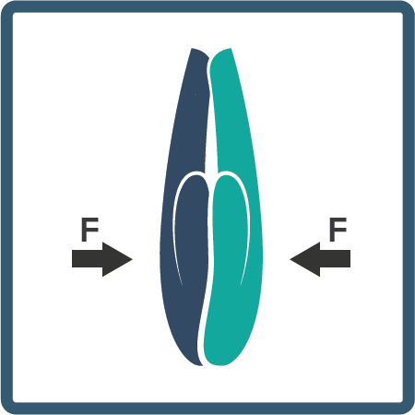
User Tests
Physical Impact
Notes:
The Physical Impact category indicates the patterns which depend on the force applied by users to each other. For example, strongly pushing to each other’s hands with a force.

Slide 52
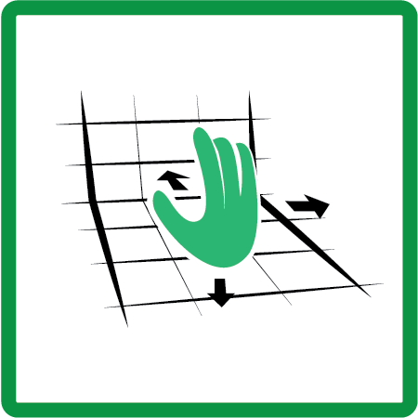
User Tests
3D Space
Notes:
Some actions led users to make use of the 3D Space in the touch areas. Users mostly prefer this kind of movement if the related action requires movement or presence in 3 dimensional space.

Slide 53
User Tests
Evaluation
First proposals of the users
Intuitiveness
Exclusiveness
Different characteristics
Different experience
Notes:
In our research, we did not take account the time passed since the users were in the design process and were encouraged to think about the patterns while proposing them. Users created several different touch patterns for some commands. Our intuitiveness definition only includes the

Slide 54
User Tests
Evaluation of Categories
Intuitiveness
Category | Total Number | Intuitive Patterns | Evaluation out of 10
Direct Manipulation | 88 | 73 | 10
Two Hand | 34 | 25 | 4
Hand Posture | 65 | 56 | 9
Two Users | 88 | 69 | 10
3D Space | 26 | 24 | 3
Physical Impact | 38 | 33 | 4
Total | 340 | 280

Slide 55
User Tests
Evaluation of Categories
Intuitiveness
Category | Total Number | Intuitive Patterns | Evaluation out of 10
Direct Manipulation | 88 | 73 | 10
Two Hand | 34 | 25 | 4
Hand Posture | 65 | 56 | 9
Two Users | 88 | 69 | 10
3D Space | 26 | 24 | 3
Physical Impact | 38 | 33 | 4
Total | 340 | 280
Notes:
Direct Manipulation is not surprising
Hand Posture and Two Users are important
Becasue we designed Dubtouch by foreseeing that it will be used with the collaboration of two users and by the use of hands as a control apparatus

Slide 56
User Tests
Evaluation of Categories
Exclusiveness
Category | Patterns with Exclusive Value | Evaluation out of 10
Direct Manipulation | 14 | 3
Two Hand | 6 | 3
Hand Posture | 39 | 8
Two Users | 51 | 8
3D Space | 8 | 4
Physical Impact | 30 | 10

Slide 57
User Tests
Evaluation of Categories
Exclusiveness
Category | Patterns with Exclusive Value | Evaluation out of 10
Direct Manipulation | 14 | 3
Two Hand | 6 | 3
Hand Posture | 39 | 8
Two Users | 51 | 8
3D Space | 8 | 4
Physical Impact | 30 | 10

Slide 58
User Tests
Evaluation of Categories
Hand Posture and Two Users are both intuitive and exclusive
Physical Impact patterns are used usually for similar actions
Notes:
Physical impact is used in commands like explosion and smash. So we can extend the research for looking into touch patterns for specific actions.

Slide 59
User Tests
Evaluation of Categories
Hand Posture and Two Users are both intuitive and exclusive
Physical Impact patterns are used usually for similar actions
Notes:
Physical impact is used in commands like explosion and smash. So we can extend the research for looking into touch patterns for specific actions.

Slide 60
User Tests
Evaluation of Categories
Hand Posture and Two Users are both intuitive and exclusive
Physical Impact patterns are used usually for similar actions
Notes:
Physical impact is used in commands like explosion and smash. So we can extend the research for looking into touch patterns for specific actions.

Slide 61
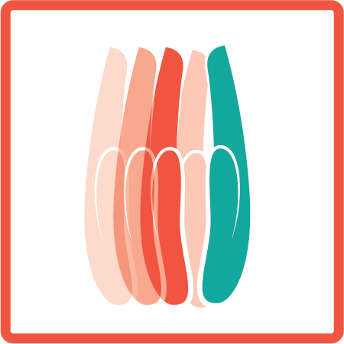
User Tests
Emotions of Touch Patterns
Firm Grip
Hold Fingers
Finger Touch
Palm Touch
Dynamic Touch

Slide 62
User Tests
Emotions of Touch Patterns
Pre-Defined Touch Patterns | Emotions, Meanings and Feelings
Firm Grip | Commitment (2 User) | Intimacy (3 User) | Merger (3 User)
Hold Fingers | Help (2 User)
Finger Touch | Exploration (3 User) | Transfer (2 User) | Distant (2 User) | Neutral (2 User)
Palm Touch | Collaboration (5 User)
Dynamic Touch | Warning (8 User) | Confusion (2 User)

Slide 63
User Tests
Emotions of Touch Patterns
Emotions | Proposed Touch Patterns
Happiness | Grip and Shake (2 User) | High Five (2 User) | Giggle (3 User) | Caress (3 User)
Melancholy | Move Downwards (6 User) | Close Fingers (3 User)
Love | Firm Grip (8 User) | Caress Gently (2 User)
Tension | Shake (4 User) | Dynamic Touch (2 User) | Hold Tight (2 User)
Fear | Intense Shake (3 User) | Sudden Touch (3 User) | Spontaneous Grip (2 User)

Slide 64
User Tests
Similar patterns may raise similar feelings in different users
These patterns can be extended to be used in games in an emotional context

Slide 65
User Tests
Similar patterns may raise similar feelings in different users
These patterns can be extended to be used in games in an emotional context

Slide 66
User Tests
Similar patterns may raise similar feelings in different users
These patterns can be extended to be used in games in an emotional context

Slide 67
Design Workshop
2 Games
D-Coder
Worm Hole

Slide 68
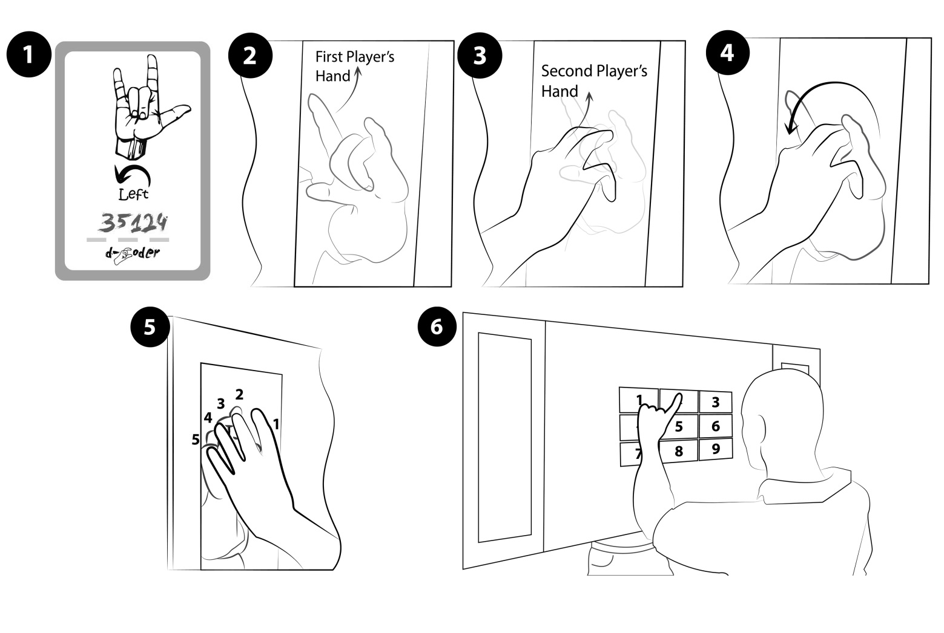
Design Workshop
D-Coder

Slide 69
Design Workshop
D-Coder

Slide 70
Design Workshop
D-Coder

Slide 71
Design Workshop
D-Coder

Slide 72
Design Workshop
D-Coder

Slide 73
Design Workshop
D-Coder

Slide 74
User Tests
Card game
Digital properties a make-up
Computational Power

Slide 75
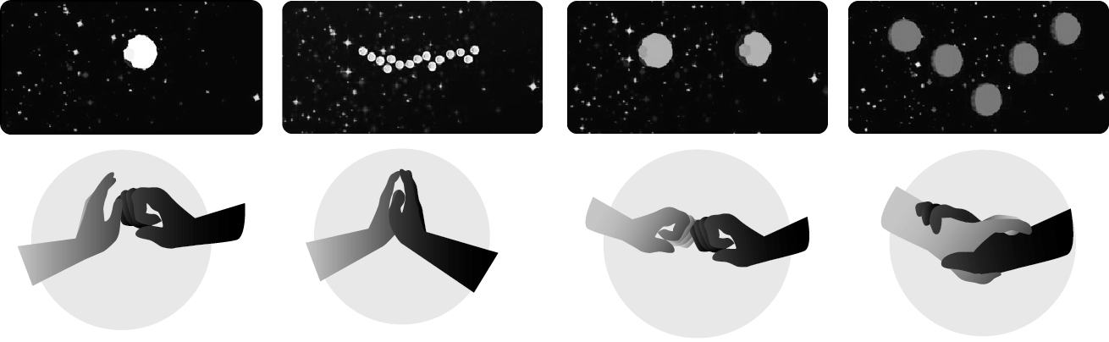
Design Workshop
Worm Hole
Power
Collaboration
Togetherness
Energy

Slide 76
Design Workshop
Worm Hole
Left hand of 1st user
Right hand of 2nd user

Slide 77
Design Workshop
Worm Hole

Slide 78
Design Workshop
Worm Hole
Card game
Digital Properties Pace and Attention
Physical Constraints
Non-Digital Rules

Slide 80
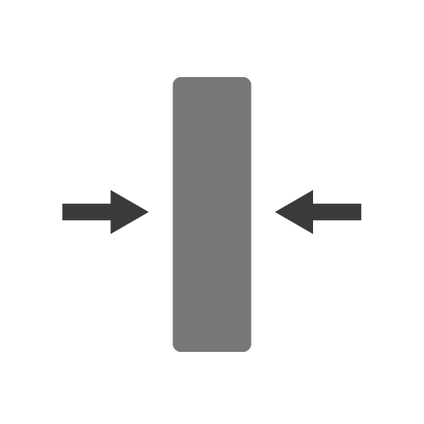
Design Workshop
Physical Restrictions

Slide 81
Design Workshop
Non Digital Game Rules

Slide 82
Design Workshop
User Study
Design Workshop
Ultimate Love

Slide 83
Design Workshop
Hints for Audial Representations

Slide 84
Design Workshop
Further Research for Visual Representations

Slide 85
Design Workshop
Results
Emergence of a new control language
Different Charateristics in games
User test results

Slide 86
Conclusion
6 Categories of touch patterns
Emotional Aspects of touch patterns
Intuitive and Exclusive patterns
Different Characteristic for Games satisfying the results of user tests
Hints for a new control language

Slide 87
Conclusion
6 Categories of touch patterns
Emotional Aspects of touch patterns
Intuitive and Exclusive patterns
Different Characteristic for Games satisfying the results of user tests
Hints for a new control language

Slide 88
Conclusion
6 Categories of touch patterns
Emotional Aspects of touch patterns
Intuitive and Exclusive patterns
Different Characteristic for Games satisfying the results of user tests
Hints for a new control language

Slide 89
Conclusion
6 Categories of touch patterns
Emotional Aspects of touch patterns
Intuitive and Exclusive patterns
Different Characteristic for Games satisfying the results of user tests
Hints for a new control language

Slide 90
Conclusion
6 Categories of touch patterns
Emotional Aspects of touch patterns
Intuitive and Exclusive patterns
Different Characteristic for Games satisfying the results of user tests
Hints for a new control language

Slide 91
Conclusion
6 Categories of touch patterns
Emotional Aspects of touch patterns
Intuitive and Exclusive patterns
Different Characteristic for Games satisfying the results of user tests
Hints for a new control language

Slide 92
Conclusion
6 Categories of touch patterns
Emotional Aspects of touch patterns
Intuitive and Exclusive patterns
Different Characteristic for Games satisfying the results of user tests
Hints for a new control language

Slide 93
DubTouch: Exploring Human to Human Touch Interaction for Gaming in Double Sided Displays
Oğuz Turan Buruk, oburuk@ku.edu.tr
Oğuzhan Özcan, oozcan@ku.edu.tr
designlab.ku.edu.tr

